Slide 1
ELA Common Core
September

Slide 2
Elementary Update
Last year | This Year | Next Year
Learned the reading standards | Learn the writing, speaking & listening, language and reading foundations | Technology??
Discovered “holes” in instruction Searched for resources and activities to teach the reading standards | Teach the reading standards w/revised scope and sequence Reflect on what worked and didn’t work Reviewing new resources Create LFS units | Teach all CCSS Create 50:50 ratio of literary and informational texts Teach new LFS units Revisit grade level gaps
Overview of text complexity | Review the text complexity of resources | Review the text complexity of resources
 | Reviewing the Next Generation Assessments Use them to assist in instruction Create new assessments | Use new assessments align to CCSS and mimic Next Generation tests

Slide 3
Middle School Update
Last year | This Year | Next Year
Learned the reading standards | Learn the writing, speaking & listening, language | Technology?
Created new units aligned to CC | Teaching all CC reading standards Search for resources and activities to teach new standards Reflect on lessons/materials Revisit grade level gaps | Teach all CCSS: RWS&LL Continue search for resources
Overview text complexity | Review resources for text complexity | Review resources for text complexity
Assessments had some CC and some GLEs | Assessments aligned to CC reading Add a performance task? | Assessments align to all CCSS Assessments will mimic Next Generation Assessments

Slide 4
High School Update
Last year | This Year | Next Year
Learned the reading standards | Learn the writing, speaking & listening, language | Technology?
Created new units aligned to CC | Teaching all CC reading standards Search for resources/ activities to teach new standards Reflect on new lessons/ materials Revisit grade level gaps | Teach all CCSS: RWS&LL Continue search for resources
Overview text complexity | Review resources for text complexity? | Review resources for text complexity
 | Assessments aligned to CC reading | Assessments align to all CCSS Assessments will mimic Next Generation Assessments

Slide 5
Activity
What do you remember?

Slide 7
Notes:
There are a lot more information about the online reporting, teacher resources etc but we are not going to focus on that at this time.

Slide 8
Types of Questions
Selected Response
Constructed Response (short/extended)
2-3 points, 5-10 min to answer
Technology Enhanced
Performance Tasks
Involve substantial research, multiple stimuli, access to spell check not grammar check
Maximum time 3-8 105 minutes, HS 120 min (first 35 for reading)
Notes:
Pam and I should read page 9, also use sample rubrics for our rubrics
Don’t go into detail with PT because that is mainly writing. Let’s show them that when we do the writing standards.

Slide 9
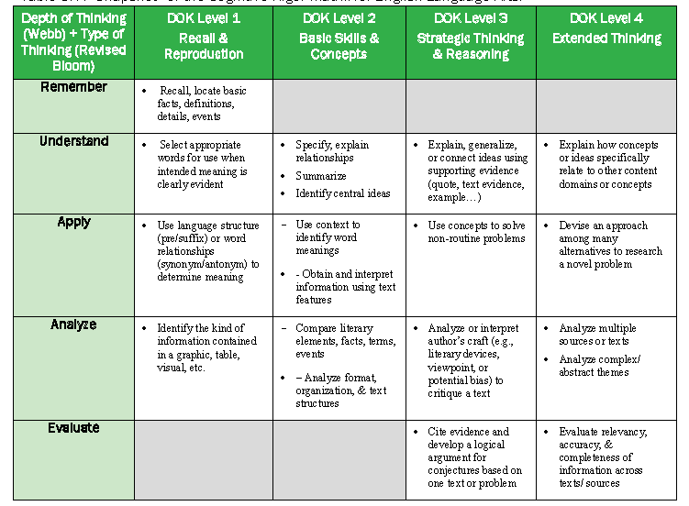

Slide 10
3-5 Samples RL
RL3 Read the sentences below. Select a sentence from the passage that best supports each inference. Drag and drop the sentence into the box below the characteristic it best supports.
RL9 Compare how the actions of the leaves in the poem are similar to the actions of the robin in the story.
RL5 Explain how the organization of the poem into different stanzas helps the reader understand its meaning. Include examples from the poem to support your answer.

Slide 11
3-5 Samples RI
RI4 The author uses the pronouns “your” and “you.” Explain how these pronouns develop the idea that laws are important to the reader. Support your answer using details from the passage.
RI4 Read the sentence from the stimulus text. Based on the root word and suffix, what does fearsome mean?
RI5 Which of the two presentations of ideas were more effective in communicating the author’s ideas? Support your answer using information from the articles.

Slide 12
3-5 Sample PT
Task Overview (105 total minutes): Title: Visiting the Dentist
Part 1 (35 minutes): Ultimately tasked with writing an informational essay telling how to maintain good dental health, students will be introduced to the topic through watching a short video and reading two articles, taking notes on these sources. They will then respond to three constructed-response questions addressing the research skills of analyzing and evaluating information.
Part 2 (70 minutes): Finally, students will work individually to compose a full-length informational essay telling how to maintain good dental health, referring to details from the video or the texts. Students may also refer to their notes or back to the video or passages as needed. Pre-writing, drafting and revising will be involved.

Slide 13
6 – 8 Samples
RL3 Which sentence from the passage best supports the idea that White Fang felt a sense of relief? (SR)
RL5 Use details from the text to explain how time and memory are used to structure the story. (CR3)
RI2 Summarize what problem once existed for the people of Curve Lake and what the solution was. (CR2)
RI2 Rearrange the statements into chronological order. (TE)
RI3/6 The author of the passage thinks that the medicine vending machine fulfills an unmet need in the Curve Lake community. Write 2–3 sentences explaining how the text supports the idea that the medicine vending machine fulfills an unmet need. (CR3)

Slide 14
Grade 8 Sample Performance Task
Task Overview (105 total minutes): Title: Developing Characters
Part 1 (35 minutes): Ultimately tasked with writing their own narrative, students will read a chart, an article and four literary excerpts, taking notes on these sources. They will then respond to three questions about the sources.
Part 2 (70 minutes): Students will work individually to compose full-length narratives, referring to their notes as needed. Pre-writing, drafting, and revising will be involved.

Slide 15
9-10 Samples RI
RI6/8 Analyze President Kennedy’s beliefs about international relations at the time of his inauguration and how he expresses those views in this speech. Support your response using details from the text.
RI6/8 What is the author’s main purpose for writing this text? Analyze how the author uses language and other strategies to reinforce the main purpose? Support your response using specific details from the text.
RI2 Summarize the main point the passage makes about Lincoln’s motivations for selecting his cabinet members. Support your summary with details from the text.
RI3 One of the most significant themes in President Kennedy’s speech is the importance of international collaboration. Click on the highlighted portions of the speech that directly support this conclusion.

Slide 16
9-10 Samples RL
RL2 During the course of this story, the pendulum undergoes a major transformation. What lesson does he learn, and how does the dial help him reach this new understanding? Use details from the story to support your response.
RL4 Which words from the poem are intended to emphasize Barbara Frietchie’s advanced age?
RL5/7 In paragraphs 1 and 2, the narrator provides two general observations about human behavior. Explain the effect this beginning has on the reader’s interpretation of the interaction between Mr. and Mrs. Bennet. Support your answer using details from the passage.
RL5/7 The poet wrote this poem using couplets, paired rhyming lines with the same meter. Describe how this structure emphasizes what takes place in the poem. Support your answer using details from the poem.

Slide 17
11-12 Samples
RI9 Identify the main idea of each passage and explain how Locke’s treatise supports Anthony’s argument.
RL4 Explain the two meanings of the word “cold” in the title and how this word develops the tone of the overall story. Support your answer using details from the story

Slide 18
HS Sample PT
Task Overview (120 total minutes): Title: Sacagawea: Fact and Fiction
Part 1 (35 minutes): Ultimately tasked with writing an informational essay on how different sources have shaped the story of Sacagawea, students will read an article, a story, and journal entries, taking notes on these sources. They will then respond to three constructed-response questions addressing the research skills of analyzing and evaluating information.
Part 2 (85 minutes): Students will compose full-length informational essays on Sacagawea, referring to their notes as needed. Students will be allowed access to the texts they viewed in part 1. Pre-writing, drafting, and revising will be involved.

Slide 19
Smarter Balanced 2014-15
Claim #1: Students can read closely and analytically to comprehend a range of increasingly complex literary and informational texts.
Claim #2: Writing, Language
Claim #3: S & L, Language
Claim #4: Conducting Research

Slide 20
What does 80% mean to you?
Notes:
We could use CC questions from ms or hs to see how they could do.

Slide 21
80%
It took about ten minutes for Jennifer to XXX everything she’d XXX- the XXX XXX history, the new XXX in Ohio to XXX the one in Colorado, Richard’s seeming XXX to keep a low XXX, Jake Blansen’s XXX about Richard being XXX and the fact that he no longer XXX for J.D. Blanchard. Pete was XXX the steering wheel and XXX when she XXX, looking as if XXX she said made perfect sense.
“I knew there was XXX XXX about that guy,” he said. “Even in the XXX, he seemed a little too XXX, you know?”
Jennifer stared at him XXX. XXX her XXX that he seemed to have seen the XXX- finally- and her XXX that he needed to be pretty much XXX on the head with the XXX, at least he was on XXX side now.
Notes:
We could use CC questions from ms or hs to see how they could do.

Slide 22
90%
It took about ten minutes for Jennifer to cover everything she’d learned— the strange credit history, the new XXXX in Ohio to replace the one in Colorado, Richard’s seeming desire to keep a low XXXX, Jake Blansen’s XXXX about Richard being XXXX and the fact that he no longer XXXX for J. D. Blanchard. Pete was XXXX the steering wheel and XXXX when she XXXX, looking as if XXXX she said made perfect sense.
“I knew there was something XXXX about that guy,” he said. “Even in the gym, he seemed a little too XXXX, you know?”
Jennifer stared at him XXXX. Despite her relief that he seemed to have seen the XXXX— finally— and her XXXX that he needed to be pretty much smacked on the head with the obvious, at least he was on her side now.

Slide 23
95%
It took about ten minutes for Jennifer to cover everything she’d learned— the strange credit history, the new XXXX in Ohio to replace the one in Colorado, Richard’s seeming desire to keep a low XXXX, Jake Blansen’s XXXX about Richard being XXXX and the fact that he no longer worked for J. D. Blanchard. Pete was tapping the steering wheel and XXXX when she finished, looking as if everything she said made perfect sense.
“I knew there was something XXXX about that guy,” he said. “Even in the gym, he seemed a little too slick, you know?”
Jennifer stared at him speechless. Despite her relief that he seemed to have seen the light— finally— and her XXXX that he needed to be pretty much smacked on the head with the obvious, at least he was on her side now.

Slide 24
Activity
Is this student struggling because he is having trouble
learning to read?
reading to learn?
Notes:
Take away from 80% activity… What I want you think about as you work with your kids this year (whether in enrichment, intervention, Z-day, whatever high school) is…

