Slide 1
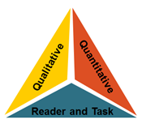
adapted from: KCCS Text Complexity Team mcopeland@ksde.org
Text Complexity

Slide 2
LEQ
How do I select appropriate texts to support the standards?

Slide 3
Activating Strategy Video Overview of Text Complexity
Notes:
http://www.youtube.com/watch?v=Q0uZwDP6cGo&feature=related

Slide 4
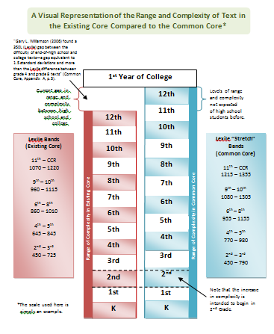
Text Complexity- Why Is This Important?

Slide 5
Ripe Figs
Notes:
The template offers space to record information for each of the three legs of the model.

Slide 6
Notes:
The template offers space to record information for each of the three legs of the model.

Slide 7
Notes:
The template offers space to record information for each of the three legs of the model.

Slide 8
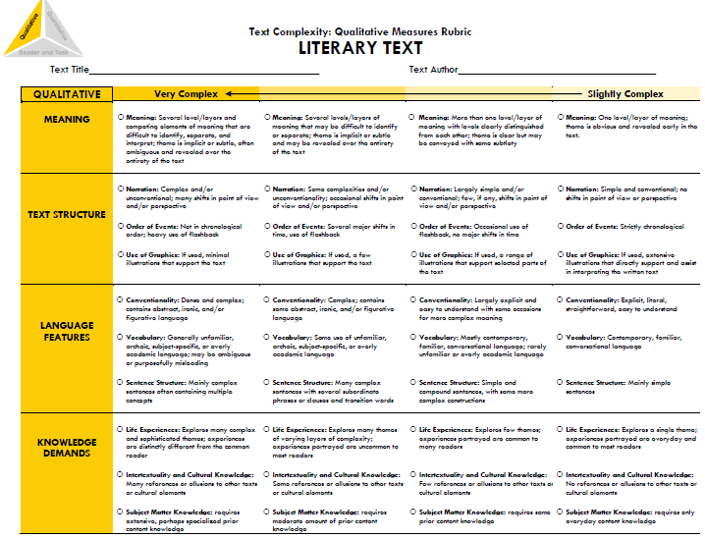

Slide 9
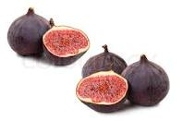
Ripe Figs
Read “Ripe Figs.”
Notes:
“Ripe Figs” – Kate Chopin – 286 words – Lexile 1030 – upper end of Grade 6-8 band

Slide 10
Notes:
The template offers space to record information for each of the three legs of the model.

Slide 11
Assignment
Elementary
Secondary
Weaving a California Tradition by Linda Yamone
Lexile:760
Task: Explain how the author uses reasons and evidence to support particular points in a text.
Why We Shouldn’t Go To Mars by Gregg Wasterbrook
Lexile: 1370
Task: Evaluate the argument, assessing whether the reasoning and evidence is relevant and sufficient.

Slide 12
Determining Text Complexity
A Four-step Process:
Determine the quantitative measures of the text.
Analyze the qualitative measures of the text.
Reflect upon the reader and task considerations.
Recommend placement in the appropriate text complexity band.
Notes:
Overview of the protocol

Slide 13
Summarizing
How do I select appropriate texts to support the standards?
Quantitative
Reader/Task
Qualitative

Slide 14
Final Thoughts
not a re-delivery presentation
teacher planning
new assessments
frustration vs. productive struggle

